Slide 1

WebAssembly
Julian Arz - 24.07.2021

Slide 2
What is WebAssembly?
WebAssembly is a portable binary format.
It lets you run languages other than JavaScript in the browser.
But also:
WebAssembly is not assembly, and it is also not (only) for the web.

Slide 3
Topics
History & Goals
Demo
Use cases
Languages

Slide 4
LLVM
Compiler for C/C++, later also Rust. Today a lot more.
C
C++
Rust
…
x86
ARM
…
…
intermediate representation (IR)
?

Slide 5




History: C++ in Browser
2011
2013
2015
2017
2019
emscripten
asm.js
Browser support
W3C Standard
C++ to JS
Simulate memory model
Ugly, but well JITable
Specifically optimize on
emscripten-generated code
WebAssembly
WASI announcement
Goals
Portable, wide range of platforms
Size- and load time efficient
Native speeds
Integrate with existing web tech
MVP with C++, later other languages
PNaCl
Sandboxed
Only Chrome
Requires Plugin

Slide 6
Why new Standard? Limitations of JS
Dynamic typing: optimizer has to check types at runtime
JIT introduces overhead & requires a few cycles to warm up
Entire script has to be downloaded before parsing can begin
GC introduces overhead & unpredictable slowdowns

Slide 7
Demo
Hello World
Heron
Labyrinth

Slide 8
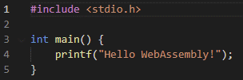
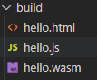
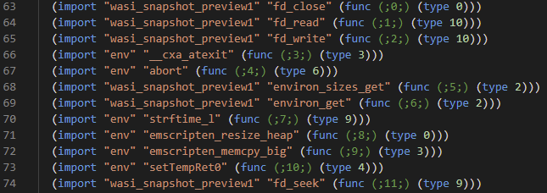
Demo: Hello World
$ emcc hello.cpp -o hello.html
Text format:
WebAssembly has no library, imports everything from environment -> portability

Slide 9
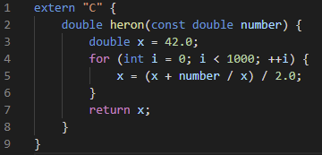
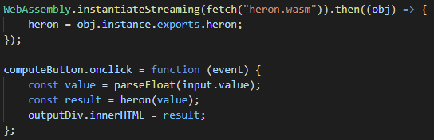
Demo: Heron
optimize for size, dce
$ emcc heron.cpp --no-entry -Os -s EXPORTED_FUNCTIONS=[_heron] -o heron.wasm
no main method
make it callable from JS
Call from JS:
Browser API

Slide 10
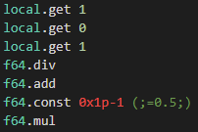
Demo: Heron
Code: Reverse Polish Notation (stack machine semantics)
It‘s not JavaScript, but is also not assembly!
Close to assembly, allows compiling while downloading

Slide 11
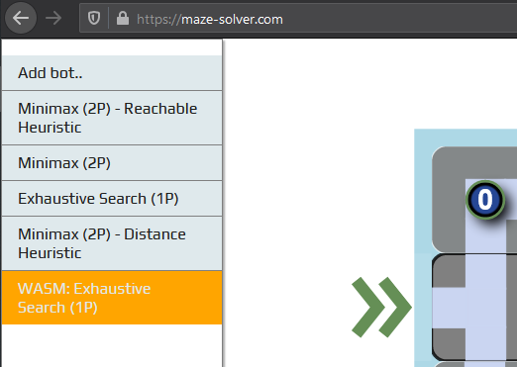
Demo: Labyrinth
Hello World & simple functions: easy
Pass / return complex data types: tricky
My first experiences (around 2019):
No clear guidelines, bad documentation, no debugging capabilities
C++ - issue? Maybe Rust better?
Today (2021):
Better documentation, both Chrome and Firefox have debuggers

Slide 12
Demo: Labyrinth
Opens new possibilities
Choose the right tool for the job

Slide 13
How does WebAssembly relate to… … JavaScript?
Goal: complement of JS, not replacement
Releases feature pressure from JS (e.g. SIMD, multi-threading, …)
Use cases: high performance, low start-up
virtual / augmented reality
gaming
CAD
language interpreters
AI / machine learning
VMs
scientific computing
video editing
cryptography

Slide 14
How does WebAssembly relate to… … the JVM?
Java Applets: heavy-weight, slow startup
WebAssembly: use existing functionalities of browsers
WebAssembly is not limited to the Web
Runtimes outside of browser: wasmtime, Wasmer, lucet
Standardization process -- WebAssembly System Interface (WASI)
Java had a similar goal: „Write once, run anywhere“

Slide 15
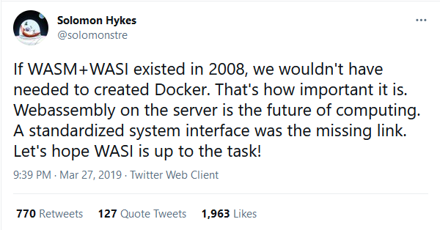
How does WebAssembly relate to… … Docker?
Containers: isolated OS-Level virtualized sandbox
WebAssembly (+ WASI): sandboxed, isolated execution of binary files
Can WebAssembly replace Docker?
Can WebAssembly replace Docker containers?
Maybe some of them
e.g. serverless: faster startup
Krustlet

Slide 16
Performance
It depends
Benchmarks (see Appendix): up to factor 2 to 4 faster, some also slower
V8 builds on 10 years of experience
If raw execution speed is the only criterion: it might not be worth it
Smaller file size, faster startup, no JIT overhead, no GC
predictable performance (same across all browsers)
Comparing inter-language performance is tricky
A programming language does not have a velocity
Implementation, language, compiler, runtime, hardware
Port and compare? Or two independent implementations?
C++ has language features tailored to performance

Slide 17
Security
WebAssembly is designed to be safe
Sandboxed, application has to import functionality
Heap is separated from rest of memory
Multiple other mitigations
Malicious software harder to detect than JS
e.g. in-browser crypto-mining
Vulnerabilities have been found (language-specific)
e.g. stack buffer overflows
compromise the attacked web-app (not the host)

Slide 18
Languages
Stable
Unstable, but usable
C/C++, Rust (both via LLVM)
Go
C# (Blazor)
A few more …
Python (e.g. pyodide)
Java?

Slide 19
Languages
Difficult to adopt: dynamic typing, garbage collection
Work in progress: add GC to WebAssembly
Idea: let host system do GC
But then, how do Python and C# do it?
In general, two options:
Compile language to WebAssembly, or
Compile runtime/interpreter to WebAssembly

Slide 20
Languages
Compile language to WebAssembly, or
Compile runtime/interpreter to WebAssembly
Stable
Unstable, but usable
C/C++, Rust (both via LLVM)
Go
C# (Blazor), .NET
A few more …
Python (e.g. pyodide)
Java
TeaVM, JWebAssembly
CheerpJ
Some more
(Ruby, Swift, PHP, …)

Slide 21
Conclusion
WebAssembly is a W3C standard for a binary format, designed to be memory-safe, portable, and fast.
Not only in browser
Main use cases: portability and performance
C#: have a look at Blazor
Java: ?

Slide 22
Sources
Articles & Presentations
https://hacks.mozilla.org/2017/02/a-cartoon-intro-to-webassembly/
http://kripken.github.io/mloc_emscripten_talk/
https://adlrocha.substack.com/p/adlrocha-can-wasm-become-the-new
https://hacks.mozilla.org/2019/03/standardizing-wasi-a-webassembly-system-interface/
Projects
https://wasmtime.dev/
https://wasmer.io/
https://github.com/bytecodealliance/lucet
https://emscripten.org/
https://blazor.net/
Talks
RustConf 2019: Clark, L. (2019). Closing Keynote https://www.youtube.com/watch?v=IBZFJzGnBoU
Podcasts
In Software Engineering Daily: Meyerson, J. (2021, March 23). Suborbital: WebAssembly Infrastructure with Connor Hicks (No. 1226)
In Software Engineering Daily: Meyerson, J. (2019, June 20). WebAssembly Compilation with Till Schneidereit (No. 855)
In Software Architecture Radio: Stine, M. (2019, March 27). WebAssembly with Brian Sletten (No. 7)
In CppCast: Turner, J & Irving, R. (2015, July 9). WebAssembly with JF Bastien (No. 15)
In CppCast: Turner, J & Irving, R. (2020, June 11). WebAssembly with Ben Smith (No. 251)

Slide 23
Sources
Misc
https://webassembly.org/docs
https://twitter.com/solomonstre/status/1111004913222324225
https://github.com/appcypher/awesome-wasm-langs
https://madewithwebassembly.com/
Security
https://webassembly.org/docs/security/
Lehmann, Daniel, Johannes Kinder, and Michael Pradel. "Everything old is new again: Binary security of webassembly." 29th {USENIX} Security Symposium ({USENIX} Security 20). 2020.
https://www.virusbulletin.com/virusbulletin/2018/10/dark-side-webassembly/
https://spectrum.ieee.org/tech-talk/telecom/security/more-worries-over-the-security-of-web-assembly

Slide 24
Benchmarks
https://medium.com/@torch2424/webassembly-is-fast-a-real-world-benchmark-of-webassembly-vs-es6-d85a23f8e193
Real world benchmark of GameBoy emulator
Two ROMs, multiple devices, three browsers, comparing JS vs. WebAssembly
Desktop: WebAssembly is 67% faster than JS on Chrome, on FF even 11 times faster. Results for mobile show greater speed-up.
https://developers.google.com/web/updates/2019/02/hotpath-with-wasm
Rotating a 16 MP image, JS vs WebAssembly.
Browsers have different execution speeds in JS (different JS-engines). WebAssembly has same speed across all browsers -> predictable performance
Measuring one-shot times, not allowing JS to be optimized from the start
Even in fastest browser WebAssembly is 20% faster than JS
https://surma.dev/things/js-to-asc/
blurring images
Rust and C - compiled WebAssembly slightly slower than fastest JS-Compiler (TurboFan)
TurboFan 50times faster than Ignition.
https://medium.com/vacatronics/webassembly-in-go-vs-javascript-a-benchmark-6deb28f24e9d
WebAssembly compiled from Go and C
is_primrecursive fibonacci: WebAssembly 3times slower than JS
iterative e: WebAssembly 4times faster than JS
https://dev.to/linkuriousdev/to-wasm-or-not-to-wasm-3803
n-body-problem: WebAssembly compiled from C, Rust, and AssemblyScript.
WebAssembly 20% to 50% slower than native, and 20% slower than JS.
https://www.youtube.com/watch?v=aC_QLLilwso
Calculating prime numbers: C++ native 2 times faster than JS, WebAssembly slightly slower than native. JS warmup is discussed.

